Slide 1
Automotive
NEVADA DEPARTMENT OF TAXATION

Slide 2
AUTOMOBILE INDUSTRY – Statue and Regulation Guidance
The Department of Taxation administers NRS & NAC Chapters 360, 360B, 372, 374 for guidance in making determinations of taxability
Department of Motor Vehicles (DMV) administers laws and regulations governing the licensing, selling, titling and other related issues (NRS & NAC 482)

Slide 3
AUTOMOBILE INDUSTRY
Information Sites:
Department of Taxation: http://www.tax.nv.gov
DMV main website: http://dmvnv.com/
DMV Registration/Title Guide: http://www.dmvnv.com/pdfforms/regtitle.pdf
Statutes and Nevada Administrative Code: http://www.leg.state.nv.us/law1.cfm

Slide 4
SALES

Slide 5
SALES TAX
Sales tax is due on the retail sale of all Tangible Personal Property unless the transaction is specifically exempted by statute
Sales tax is held in-trust by the dealership and must be remitted to the Department monthly/quarterly
Applicable sale tax rate is charged based upon the county where the actual sale occurs not where the purchaser resides
NRS 360B.095

Slide 6
SALES
Included
Total amount of consideration for property sold
Charges necessary to complete the sale
Excluded
Discounts offered by the seller
Unwinds—Purchaser is made whole all funds returned
Labor charges when separately stated
Trade-in of used vehicle / vessel (allowable sales tax credit)

Slide 7
SALES
Maintenance Contracts (warranty) separate from any manufactures warranty if negotiated for a price at the time of the sale are considered part of the sale and are subject to sales tax
Optional Maintenance contracts (warranty) are not taxable; however any parts covered by the warranty at the time of repair are subject to sales or use tax

Slide 8
SALES
After-Market Warranty: The parts used for these repairs are subject to use tax. If the parts are shown separately, then only those tangible parts are subject to sales or use tax.
Repair labor is not taxable
If the parts are not shown separately, the transaction is considered ‘bundled’ and the entire transaction is subject to the tax. (NAC 372.045)

Slide 9
SALES
Vehicle sales to Military personnel are generally subject to sales tax.
Occasionally a dealer may get this Active Duty Military Governmental Services Tax Exemption Affidavit.
THIS FORM DOES NOT EXEMPT THE PURCHASE FROM SALES TAX…..it only exempts the Governmental Services tax due at registration with DMV
NOTE: This exemption applies ONLY to Active Duty Military, and not the members of the Nevada National Guard.

Slide 10
SALES
Nevada Residence (Permanent or Temporary) Sales are taxable if they reside in Nevada
Rebates: Manufacture Rebates do not affect the sales tax on the selling price of a vehicle. This is a form of payment
Dealer Discounts: Dealer discounts are considered discounts and are not taxable. It reduces the selling price of the vehicle.

Slide 11
SALES
Theft Deterrent Systems: Any charge for car alarms or similar devices are subject to sales tax.
Any service required as part of the sale such as document fees are subject to sales tax. This also includes any service that is necessary to complete the sale such as smog fees. (NRS 372.025, NRS 360B.480)
Title fees are not taxable

Slide 12
SALES
Vehicle Give-Aways: Example a casino is giving away a vehicle in a contest or promotional program. This is a purchase by the casino for its promotion. Sales tax is payable by the casino.
The casino is allowed to pass on its tax burden to the contest winner provided the contest rules have been posted.

Slide 13
SALES
Vehicle Give-Aways (continued)
No drive-away exemption is allowed for this type of transaction.
Any upgrades required by the contest winner that is outside the agreement is subject to tax to the winner
If a vehicle is provided strictly as product placement/display for the promotion then no tax is due

Slide 14
SALES
Tires sold at retail are taxable
Smog fees are taxable (if sold in conjunction with vehicle sale).
Doc(ument) fees are taxable.

Slide 15
UNWIND
Unwind – Sale is essentially cancelled, the dealership and customer are both made “whole”. A reasonable restocking fee may be charged by the dealership.
If a vehicle used as a trade-in is no longer in the dealership’s inventory, then the value of the trade-in should be used

Slide 16
REPOS
Vehicle Repossession -- No refund of the sales tax charged and remitted on the original deal. NRS 372.368, Deduction of certain bad debts from taxable sales may be appropriate when properly documented.

Slide 17
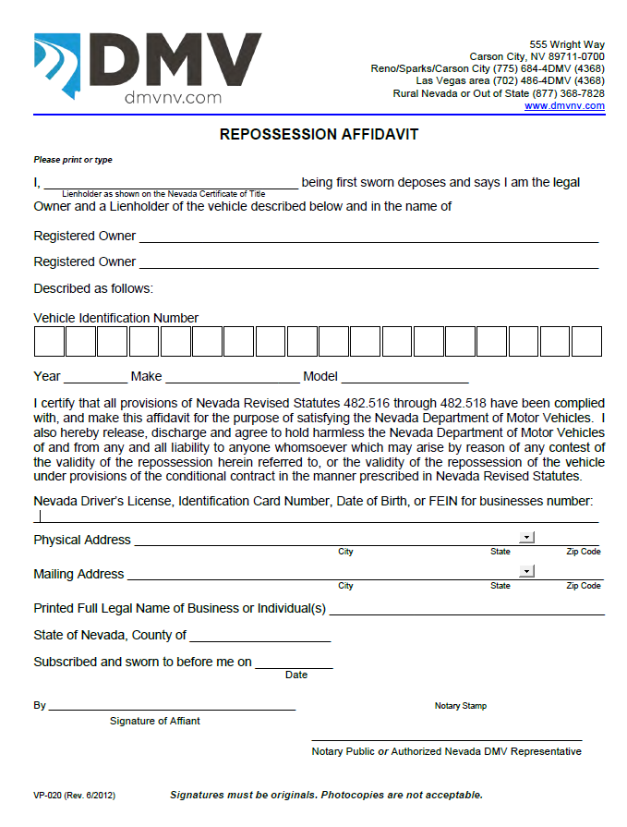
This form should be in the deal file whenever a repossession occurs. Note this form also includes a notary section.

Slide 18
SALES
The selling price of any vehicle delivered in this state by a registered retailer who is providing a courtesy delivery to a customer on behalf of an unregistered out-of-state seller should be included in the gross receipts of the delivering retailer.
Sales tax should be collected on the sale at the time of delivery

Slide 19
SALES
Any sale in one county is subject to that county’s sales tax rate regardless of the fact that the purchaser is a resident of another county. Where the sale takes place determines the rate of taxation.

Slide 20
ABSORPTION OF TAX
Taxpayers SHOULD NOT advertise they will pay the sales tax (NRS 372.115)
Taxpayers CAN state that “sales tax is included….” (NAC 372.760)
If there is no statement on the invoice or a sign indicating the same, the entire amount or portion that is separated out relating to tangible personal property is considered taxable (NAC 372.760)

Slide 21
TRADE - INS
Trade in of a vehicle towards the purchase of another vehicle, reduces the purchase price by the value of the trade in. Sales tax is computed and paid on the net selling price.
Trade-in of a leased vehicle has no affect on the sales tax computation.

Slide 22
TRADE - INS
Trade-in of a vessel (boat) towards the purchase of a vehicle, tax credit is computed on the value of the vessel based on the county rate minus the 2% state tax.
Whenever a vessel is involved, the Supplemental Trade-In form provided by the Department of Taxation must be used

Slide 23
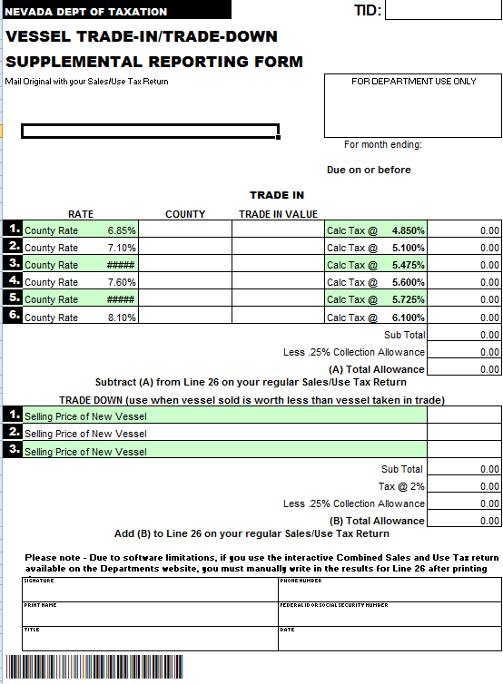
Form to use when a vessel is involved in the trade in or trade down

Slide 24
TRADE - INS
Trade-in of a vehicle towards the purchase of a boat (vessel), the trade-in tax credit is the full county tax rate.
Trade-ins are to be reported as an exempt sale in Column B of the sales tax return.

Slide 25
TRADE - INS
Trade-in tax credit on vehicle not purchased in Nevada
A trade-in allowance is allowed on all vehicle trade-ins regardless of where the trade-in vehicle was initially purchased

Slide 26
TRADE - INS
Trade-downs-- A vehicle/vessel that is given a trade-in credit which is higher than the selling price of the new vehicle/vessel, the trade-in tax credit cannot exceed the tax of the selling price of the new vehicle/vessel
Trade-downs of vessels are subject to 2% tax on the selling price of the new vessel

Slide 27
LEASES

Slide 28
LEASE DEFINITIONS
Residual Value -- Estimated fair market value of the vehicle at the end of the lease
Capitalized Cost -- Value agreed upon for the vehicle to be leased, including add-on costs, admin fees, prior lease balance, etc.
Capitalized Cost Reduction -- Amount of any net trade-in allowance, rebate, etc. that is used to reduce the amount to be leased

Slide 29
LONG TERM VEHICLE LEASES
A long term lease is for a period over 31 days (NRS 482.053)
Information on the lease:
Value of leased vehicle
How payment at inception is disbursed
Computation of monthly sales tax
Estimated (residual) value at end of lease
Purchase option

Slide 30
TAXABLE ITEMS IN A LEASE
Monthly payments
First payment paid to dealership, remainder remitted to/by leasing company
Doc fees showing on lease
“Smog Fees” showing on lease
Capitalized Cost Reduction

Slide 31
Example of Vehicle Lease
Please note that this is only a partial example of a completed lease

Slide 32
EXEMPT SALES

Slide 33
EXEMPT SALES
Dealer issued discounts
Drive-away permit costs
Title fees, Registration fees
Optional Warranties, service only warranties
Out of state sales
Sales to border state employees

Slide 34
EXEMPT SALES
Exempt entities
Government (U.S. or Nevada)
Religious*
Charitable*
Educational*
Nevada National Guard*
Sales to residents of other states **
Sales for resale ***

Slide 35
EXEMPT SALES
* Must have Department-issued exemption letter on file
** Must have completed Affidavit of Purchaser, drive-away permit and other supporting documents
*** Must have resale certificates on file

Slide 36
SALES TO OUT OF STATE RESIDENTS
An vehicle deemed as an out of state sale must have documentation to prove it will be taken and used out of state.
Documents required include but not limited:
Out of state driver’s license
Out of state insurance
Out of state employment/residency
Drive away permit
Notarized Affidavit

Slide 37
SALES TO OUT OF STATE RESIDENTS
Purchaser has 15 days to remove the vehicle form this state
Nevada residents are not allowed to be issued Drive-Away permits Note: If the purchaser has a residence in both Nevada AND another state, the sale is subject to sales tax.
Reciprocity does not affect the transaction

Slide 38
RECIPROCITY
Vehicles with substantial prior use in another state and subsequently moved to Nevada, there is no further tax due.
Vehicles recently purchased in another state, and that state’s tax was charged, and the vehicle moved to Nevada, if Nevada tax is higher, the difference between the two states will be assessed at the time of registration
If the tax in the other state is higher then no further tax is due.

Slide 39
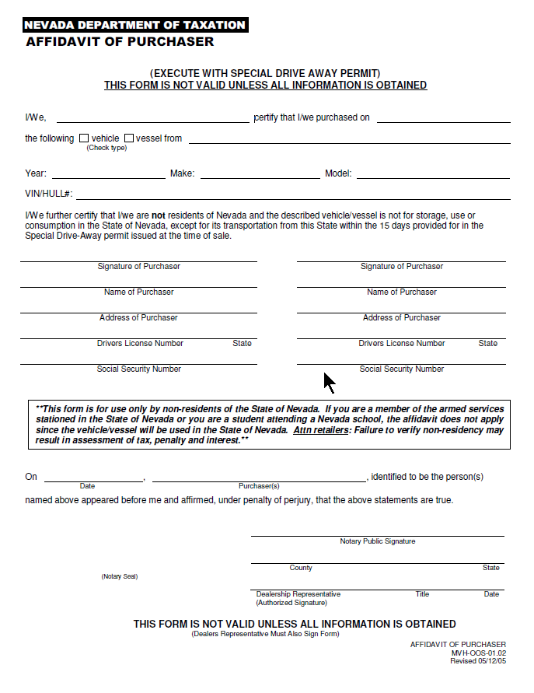
This is the drive away affidavit. It must be completed in full and customer’s signature must be notarized at time of sale.

Slide 40
USE TAX

Slide 41
USE TAX
Sales tax should be paid to the vendor or use tax accrued on supplies used in the repair of vehicles
Likewise sales or use tax must be paid for equipment or supply items that are not incorporated into vehicle repairs.
Supplies include cleaning rags, masking tape, gloves, glass cleaner and any other items of a similar nature.

Slide 42
USE TAX
Examples of when use tax is due
Giveaway items
Self-use items purchased without tax
Internet purchases for self use where Nevada tax is not charged
Vehicles placed in service for use by dealership i.e. courtesy transport vans
Parts for company vehicles

Slide 43
REPLACEMENT PARTS
Sales and Use Taxes do not apply to the purchase of replacement parts if the repairs are pursuant to the provisions of a warranty or guaranty. True only if the warranty or guaranty was part of the original sale. Example: Manufacturers new car warranties
NAC 372.460(1)

Slide 44
USE TAX
Loaner – Demonstration Vehicle Usage:
Effective 10/24/2014: If the cumulative period of all the loans of the motor vehicle by the dealer is more than 180 days, the usage will be subject to tax at the cost of the vehicle to the dealer.
This includes vehicles with Loaner Plates & Dealer Plates.

Slide 45
USE TAX
Loaner – Demonstration Vehicle Usage (con’t)
A written record must be maintained by the dealer and available upon request of the Department showing the usage of the loaned vehicle.
Absence of such a log could subject the full value of the vehicle to sales/use tax.

Slide 46
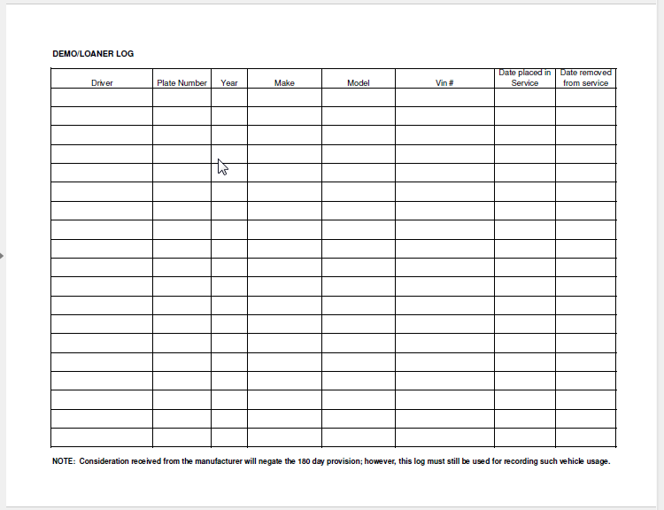
EXAMPLE OF DEMONSTRATOR/LOANER LOG

Slide 47
OTHER

Slide 48
TIRE TAX
Tire tax is $1 per new tire (note: this does not apply to the tires that are placed on a vehicle being sold) plus applicable sales tax.
When a dealership purchases tires for its vehicles in inventory, a resale certificate should be provided to the tire supplier.

Slide 49
TIRE TAX
If the dealership is purchasing new tires for their vehicles placed in service for use in the business, or for personal vehicles, the tire tax and sales tax should be paid.
If the dealership is in the business of selling tires at retail, it must register for the tire tax

Slide 50
Electronic Filing Requirements
All businesses remitting payment of $10,000 or greater must register and pay using the Departments online tax system Nevada Tax
Additional information and details on how to register, submit a tax return and pay your taxes please refer to:
https://www.nevadatax.nv.gov/web

Slide 51
RECORDS TO BE KEPT
Purchase invoices: i.e. parts, sublet, supplies
Sales journals
General ledgers
Deal Folders
Affidavits and Drive–away permits
Must keep records for four (4) years

Slide 52
WRITTEN RESPONSE
Most tax issues can be addressed by contacting the Department of Taxation. Please be advised that any responses to inquires made to the Department are only binding if put in writing, such as Nevada Revised Statutes, Administrative Code, Nevada Tax Notes, or in written correspondence.

Slide 53
DEPARTMENT OF TAXATION Contact Information
Office Hours: Monday-Friday (Except on Holidays)
8:00 AM – 5:00 PM
Contact our Call Center at
1-866-962-3707
Las Vegas
Grant Sawyer Office Building
555 E. Washington Avenue
Suite 1300
Las Vegas, NV 89101
Henderson
2550 Paseo Verde Parkway
Suite 180
Henderson, NV 89074
Carson City:
1550 College Parkway
Suite 115
Carson City, NV 89706-7937
Reno:
4600 Kietzke Lane
Building L, Suite 235
Reno, NV 89502

