Slide 1
STATE OF NEVADA DEPARTMENT OF TAXATION
CONSTRUCTION

Slide 2
CONSTRUCTION CONTRACTORS Construction Contract
NAC 372.190(1) Construction Contract for improvement to real property defined: A contract for
Erecting,
Constructing,
Affixing a structure
Type of contracts:
Formal or informal,
Advertised contracts,
Negotiated contracts,
Fixed price contracts,
Cost reimbursable contracts,
Lump-sum contracts,
Time and material contracts

Slide 3
CONSTRUCTION CONTRACTORS Construction Contractor
NAC 372.190(2) Construction Contractor Defined:
Any person who acts solely in a professional capacity to alter, repair, add to, remodel or otherwise improve any real property.
This includes:
Subcontractor,
interior decorators,
specialty contractors
This does not include:
Licensed architect,
licensed engineer
Manufacturer of: Modular homes, sectionalized housing, prefabricated homes or factory-built home except when installing a prefabricated unit to real property under contract with a government entity.

Slide 4
CONSTRUCTION CONTRACTORS Application of Tax
NAC 372.200 Tangible Personal Property purchased for performance of contract:
A construction contractor is considered a consumer of all tangible personal property purchased for use in improving real property
A construction contractor is required to pay the tax on all material purchases that will be used in the construction job

Slide 5
CONSTRUCTION CONTRACTORS Public Works Contracts
NRS 338.1423
A contractor may not enter into a contract for a public work claiming to be a constituent part of the governmental entity which sponsors or finances the public work
A contract for a public work may be entered into provided that the contract requires the payment of any state/local taxes that would normally be due had the contract not been with a tax-exempt entity
If the public body is going to perform the public work itself, it is not required to pay any local or state taxes for the purchase and use of construction materials or goods
Technical Bulletin 16-0002

Slide 6
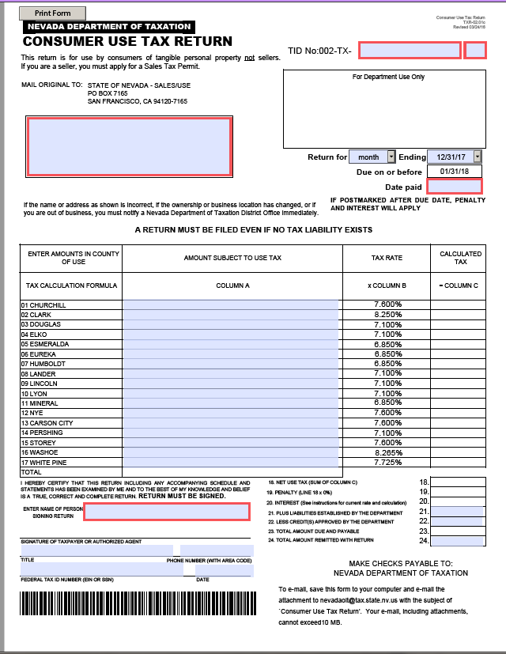
CONSTRUCTION CONTRACTORS Consumer Use Tax Return

Slide 7
CONSTRUCTION CONTRACTORS Change in Sales Tax Rate
NRS 377B.110(6) Construction contractors bid future jobs which include the current sales tax rate.
When the sales tax rate changes….
the construction contractor can apply for an exemption from the increased tax rate. Contractors must complete a Contract Summary Form and submit to the Department. Once approved, the contractor will be required to self-report the use tax at the former tax rate. Complete instructions and the form are available on the Department of Taxation’s website under “Common Forms”.

Slide 8
CONSTRUCTION CONTRACTORS Resale Certificates
A construction contractor may be registered as a retailer
As a retailer, the contractor may use a resale certificate for purchases, and report the tax when the materials are used in a job or sold at retail.
A retailer construction contractor may NOT use a resale certificate for purchases of tools or supplies which are used in the trade.

Slide 9
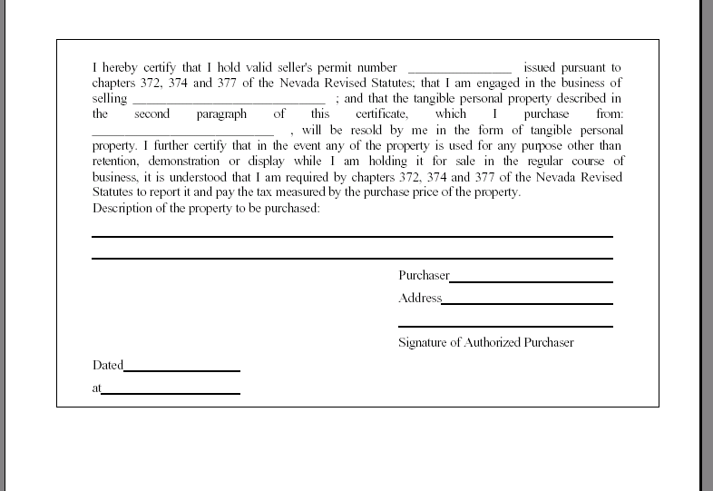
CONSTRUCTION CONTRACTORS Resale Certificates

Slide 10
CONSTRUCTION CONTRACTORS Fabrication Labor
NAC 372.380 Producing, Fabrication, Processing
Fabrication labor is labor which results in the creation of tangible personal property.
Fabrication labor is taxable in a retail sale where no installation to real property is involved.
A contract for improvement to real property which includes fabrication and installation is not considered a retail transaction; the contractor is liable for tax on the materials only in such a transaction.

Slide 11
CONSTRUCTION CONTRACTORS Purchases out of State
Taxes Paid
NRS 375.185 Imposition and rate
Materials purchased out of state and delivered to Nevada for a Nevada job are subject to Nevada tax.
NAC 375.055 Use tax for purchase outside of Nevada
Tax legitimately paid to other state is honored by Nevada; however, if the other state tax rate is lower than the Nevada rate, the difference is due to Nevada

Slide 12
CONSTRUCTION CONTRACTORS RECORDS TO KEEP
NRS 372.735 Records to be kept by sellers, retailers and others consuming in this State tangible personal property from a retailer:
Purchase invoices
Sales journals
General ledgers
Job files
Other records
Must keep records for four (4) years

Slide 13
WRITTEN RESPONSE
Most tax issues can be addressed by the Department of Taxation. Please be advised that any responses to inquires made to the Department are only binding if put in writing, such as Nevada Revised Statutes, Administrative Code, Nevada Tax Notes, or in written correspondence.
Notes:
13

Slide 14
DEPARTMENT OF TAXATION Contact Information
Our offices are open Monday-Friday
8:00 AM – 5:00 PM
Contact our Call Center at
1-866-962-3707
Southern Nevada:
Grant Sawyer Office Building
555 E. Washington Avenue
Suite 1300
Las Vegas, NV 89101
OR
2550 Paseo Verde Parkway
Suite 180
Henderson, NV 89074
Carson City:
1550 College Parkway
Suite 115
Carson City, NV 89706-7937
Reno:
4600 Kietzke Lane
Building L, Suite 235
Reno, NV 89502

