Slide 1
STATE OF NEVADA DEPARTMENT OF TAXATION
Modified Business Tax (MBT)

Slide 2
Types: BUSINESS TAX
Financial Institutions and Mining – NRS 363A
Business Tax (General Business) – NRS 363B

Slide 3
BUSINESS TAX, Financial Institution and Mining
Financial Institutions is defined as pursuant to NRS 363A.050:
An institution licensed, registered or otherwise authorized to do business in this State.
Includes: A person requiring or holding or designated, or registered pursuant to:
A solicitation permit or license, Commodity Exchange Act, Securities Exchange Act , Public Utility Holding Co. Act Investment Company Act, Saving and Loan Holding Co., Bank Holding Co., Real Estate Investment Co., Savings Association or Bank , A Thrift Institution, Venture Capital Co., Nation Bank Act
Does not include:
A Credit Union per NRS 678, or Federal Credit Union, Federal Land Credit Association. A person who is primarily engaged in the sale, solicitation or negotiation of insurance if more than 50% of the annual income is commission from these activities.
Mining: A person who is subject to the tax on net proceeds of minerals pursuant to NRS 362.100 (NRS 363A.030)

Slide 4
BUSINESS TAX (General Business)
A Nevada Employer is defined as per NRS 363B.030:
Any employer who is required to pay a contribution to the Department of Employee Training and Rehabilitation/Employment Security Division pursuant to NRS 612.535 for any calendar quarter.*
*NRS 612.535 Unemployment Compensation

Slide 5
BUSINESS TAX Exceptions
Indian Tribe
Nonprofit organization under 26 U.S.C. 501(c)
Political subdivision
A person who performs a domestic service (Example: housekeeper, nanny)
NRS 363A.030
NRS 363B.030

Slide 6
Payroll TAX - Financial Institution and Mining
Payroll Tax: Imposition
Imposition – A excise tax at the rate of 1.853% of the wages paid by the employer during a calendar quarter. NRS 363A.130.
Allowable Credit – 50% of the amount of Commerce Tax paid in the proceeding taxable year. NRS 363A.130.
Payroll Tax: Deductions and Credits
Deductions – Health Insurance NRS 363A.135.
Credits – Employees matching contributions to prepaid tuition and college savings trust NRS 363A.137 and Donation to Scholarship Organization through Nevada Education Choice Scholarship Program NRS 363A.139.

Slide 7
PAYROLL TAX - BUSINESS TAX (General Business)
Payroll Tax: Imposition
Imposition – A excise tax at the rate of 1.378% of the wages paid by the employer during a calendar quarter that exceed $50,000. NRS 363B.110.
Credit – 50% of the amount of Commerce Tax paid in the proceeding taxable year. NRS 363B.110.
Payroll Tax: Deductions and Credits
Deductions – Certain Health Care Insurance NRS 363B.115.
Credits – Employees matching contributions to prepaid tuition and college savings trust NRS 363B.117 and Donation to Scholarship Organization through Nevada Education Choice Scholarship Program NRS 363B.119.

Slide 8
BUSINESS TAX Filing Requirements
Returns are due by the last day of the month following the calendar quarter in which the employer is required to pay Unemployment Compensation NRS 363A.130, NRS 363B.110
(Example: quarter ended September 30, return is due by October 31)
Late filing penalty up to 10%, NRS 360.417.
Interest is calculated at .75% per month on the unpaid tax balance, NRS 360.417.

Slide 9
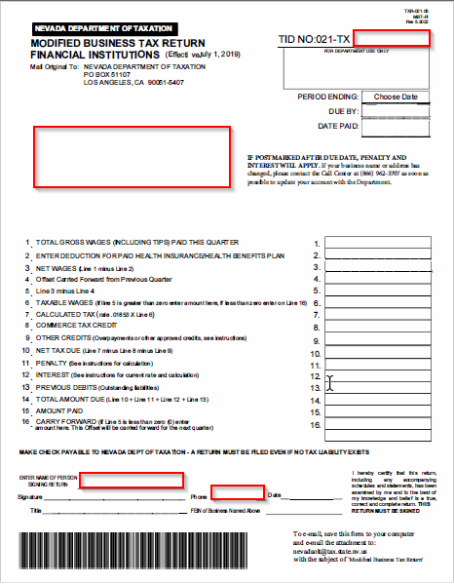
BUSINESS TAX FINANCIAL Institution Return
This form is a universal form that will calculate tax, interest and penalty for the appropriate periods if used on-line.

Slide 10
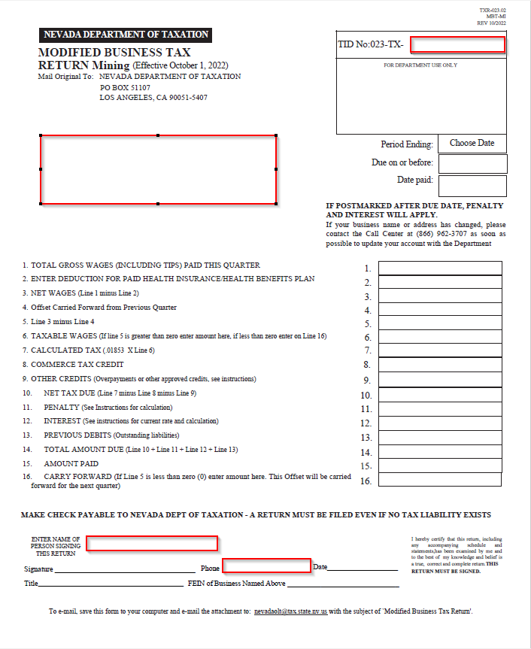
BUSINESS TAX Mining Return
This form is a universal form that will calculate tax, interest and penalty for the appropriate periods if used on-line.

Slide 11
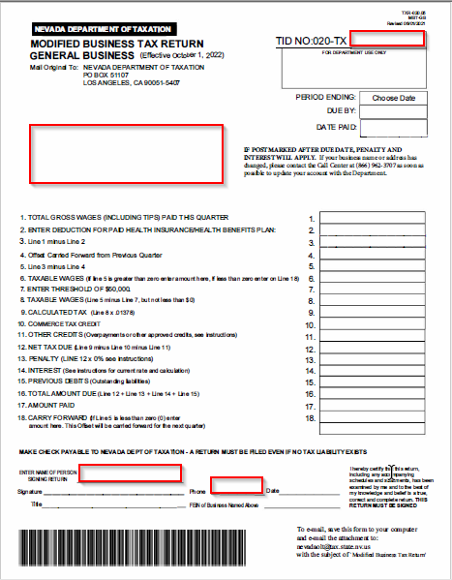
BUSINESS TAX GENERAL Business Return
This form is a universal form that will calculate tax, interest and penalty for the appropriate periods if used on-line.

Slide 12
BUSINESS TAX Classification
NAICS Code
(North American Industry Classification System)
NAICS is a standard used by Federal statistical agencies in classifying business establishments related to the U.S. business economy, run by the U.S. Government as used on your Federal Income Tax Return.
To find your NAICS code one source is this website, NAICS U.S. Census Bureau.

Slide 13
BUSINESS TAX Reporting
MBT is imposed on the Total Gross Wages (including tips), as defined in NRS 612.190 (wages paid for personal services) to Unemployment Compensation.
Line “3” on the Employer’s Quarterly Contribution and Wage Report Form NUCS 4072 or UI Nevada system printout.
NRS 363A.130 and NRS 363B.110

Slide 14
BUSINESS TAX Deductions
Health Insurance NRS 363A.135, NRS 363B.115:
Any amount paid by the employer for health insurance or a health benefit plan for its employees in the calendar quarter for which the tax is paid. The deduction may include:
Premiums for a policy of health insurance for employees or amounts paid by a self- insured employer in a qualified employee welfare benefit plan for claims, direct administrative services, premiums or aggregate stop-loss insurance coverage and amounts paid by an employer to a Taft-Hartley trust under 29 U.S.C. 186(c)(5)

Slide 15
BUSINESS TAX Deductions cont’d
An employer may not deduct under Health Care Deduction:
Amounts paid for industrial injury or occupational disease insurance.
Payments made by the employee or amounts deducted from the wages of employees for health care/health insurance.
Life insurance.
AD&D insurance.

Slide 16
BUSINESS TAX Credits
Commerce Tax Credit NRS 363A.130 and NRS 363B.030:
50% of the amount of the commerce tax paid by the employer in the proceeding taxable year.
Used for any of the four calendar quarters following the end of the taxable year.
The taxable year is from July 1 to June 30 of each year.
There is no refund to the taxpayer for any unused credit.
Employees matching contributions to prepaid tuition and college savings trust NRS 363A.337 and NRS 363B.117:
Contribution made to the savings account by an employee of the employer.
The credit available is equal to 25% of the matching contribution, not to exceed $500 per contributing employee per year.
Any excess of the credit may be applied to the tax liability for five years after the year in which the matching contribution was made.

Slide 17
BUSINESS TAX CREDITS
Donation to Scholarship Organization through Nevada Education Choice Scholarship Program NRS 363A.139 and NRS 363B.119:
The taxpayer must:
Notify the scholarship organization of the intent to donate and seek a credit.
The scholarship organization must apply to the Department of Taxation for approval prior to accepting the contribution.
The Department of Taxation, if approving the request, will notify the scholarship organization of the approved amount.
Upon approval, the scholarship organization shall notify the taxpayer who must, not later than 30 days after receiving the notice, donate the money to the scholarship organization.
Failure to meet the deadlines described above shall result in a forfeit of any claim to the credit by the taxpayer.

Slide 18
BUSINESS TAX – Transferable tax Credits
Capital Investment at Least 3.5 Billion Abatement of taxes – NRS 360.750:
The lead participant in a qualified project under abatement of taxes may apply to the Office of Economic Development for a certificate of eligibility for transferable tax credits.
The transferable credit may be applied to any tax imposed by:
NRS 363A or NRS 363B – Modified Business Tax
NRS 463.370 – Gaming License Fees
NRS 680B – Insurance Fees and Taxes.

Slide 19
BUSINESS TAX – Transferable tax Credits
Film Credit NRS 360.759:
A producer of a qualified production that is produced in this State in whole or in part may on or before December 31, 2017, apply to the Office of Economic Development for a certificate of eligibility for transferable tax credits for any qualified expenditures and production costs identified in NRS 360.7591.
The transferable tax credits may be applied to:
NRS 363A and NRS 363B – Modified Business Tax
NRS 463.370 – Gaming License Fees
NRS 680B – Insurance Fees and Taxes

Slide 20
BUSINESS TAX - Carry Forward
Carry Forward NRS 363A.135(3) & NRS 363B.115(3):
If allowable health deductions for any quarter exceed the wages paid in that quarter, the amount that is in excess of reported wages is allowed to be carried forward and used as a deduction in future reports.

Slide 21
BUSINESS TAX - Leasing Companies
Employees Leasing NRS 616B.670:
The client company of an employee leasing company is deemed the employer of the employees it leases pursuant to NRS 616B.691. This means that employee leasing companies may now take the current threshold credit deduction for every client company they service.

Slide 22
BUSINESS TAX - Questions
Have a question?
Ask the Department for a written response. Most tax issues can be addressed by the Department of Taxation. Be advised that any responses to inquires made to the Department are only binding if put in writing, such as Nevada Revised Statutes, Administrative Code, Nevada Tax Notes, or in written correspondence.
Notes:
22

Slide 23
DEPARTMENT OF TAXATION Contact Information
Our offices are open Monday-Friday
6:30 AM – 5:00 PM
Contact our Call Center:
1-866-962-3707
Carson City Reno Las Vegas
1550 College Parkway 4600 Kietzke Lane 700 E Warm Springs Rd
Suite 115 Building L Suite 235 2nd Floor
Carson City, NV 89706 Reno, NV 89502 Las Vegas NV 89119

