Slide 1
SEG & SAR Reporting 101
September 2015 – Dept. of Taxation, Local Government Services

Slide 2
Look Familiar?

Slide 3
TOPICS
NRS 361.390
Segregation of the Roll (SEG) – Due Dates and Uses
Redevelopment Areas (TIF)
SEG Report
Assessor’s SEG – Ma / Pa Review
Excel Formula Reviewing Tools
Report Dependents and Precedents
Ball Park Estimates by District
Understanding the Pro Forma Report
Issues: Exemptions & Abatements

Slide 4
TOPICS (Cont.)
Statistical Analysis of the Roll (SAR) – Due Dates and Uses
SAR Changing Environment
Changes in SAR Format
Reasons Driving SAR Changes
Division Implementation
Wrap Up
Questions and Answers

Slide 5
NRS 361.390
NRS 361.390 Duties of county assessor; projections for current and upcoming fiscal years. Each county assessor shall:
1. File with or cause to be filed with the Secretary of the State Board of Equalization, on or before March 10 of each year, the tax roll, or a true copy thereof, of his or her county for the current year as corrected by the county board of equalization.
2. Prepare and file with the Department on or before January 31, March 5 and October 31 of each year, a segregation report showing the assessed values for each taxing entity within the county on a form prescribed by the Department. The assessor shall make projections of assessed value for the current fiscal year and the upcoming fiscal year regarding real and personal property for which the taxable value is determined by the assessor. The Department shall make any projections required for the upcoming fiscal year regarding the net proceeds of minerals and any property for which the taxable value is determined by the Nevada Tax Commission.
3. Prepare and file with the Department on or before May 5 for the unsecured roll, on or before August 10 for the secured roll, and on or before October 31 for the unsecured roll and the secured roll, a statistical report showing values for all categories of property on a form prescribed by the Department.

Slide 6
SEG - Due Dates and Uses
January 31st
Volatility Gauge
Early Look at Values / Trends
Planning / Budgeting Preparation
NRS 361.4722 - Tax Cap Factors (most recent year)
Preliminary Revenue Projections
March 5th
Planning / Budgeting
Property Tax Rates for Nevada Local Governments (Redbook)
Consolidated Tax Distribution (CTX)
Motor Fuel Tax Distribution
NRS 361.4722 - Tax Cap Factors (2 most recent years)
Final Revenue Projections (March 15)
October 31st
True Up After Roll Close; Basis for Year to Year Comparisons
NRS 361.4722 - Tax Cap Factors (2nd most recent year)
State Biennium Budget (Historical Trend)

Slide 7
Redevelopment Areas
Nevada Revised Statutes (NRS) 279 “Redevelopment of Communities” contains the legal structure of local redevelopment agencies and other related state regulations on the purpose, the creation, and the activities of local redevelopment agencies in Nevada.
All property tax revenues generated from properties in a redevelopment district in excess of the base level (Area 1 on Figure 1 shown on next page) are distributed, with a few exceptions, to only the redevelopment agency.
A redevelopment agency will only receive property tax revenues from the district if the property tax base grows over time.
Redevelopment is not a new tax.
Source: University of Nevada Cooperative Extension. Fact Sheet 13-29, Funding Economic Development in Nevada: Redevelopment. Frederick Steinmann, Extension Educator/Assistant Professor.

Slide 8
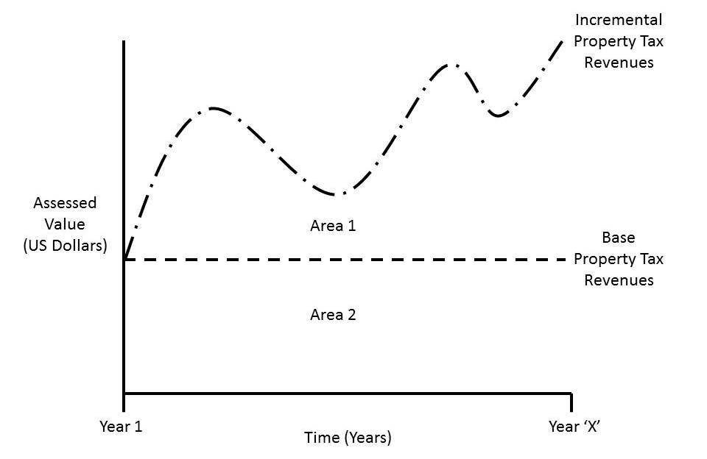
Redevelopment Areas (cont.)
Figure 1:
Growth
Base
Source: University of Nevada Cooperative Extension. Fact Sheet 13-29, Funding Economic Development in Nevada: Redevelopment. Frederick Steinmann, Extension Educator/Assistant Professor.

Slide 9
SEG – Reporting
COLUMN D Excludes incremental growth from entities that contain redevelopment districts. The value of a redevelopment agency equals its incremental value (total assessed value less the base assessed value).
COLUMN F Excludes incremental growth from entities that contain redevelopment districts. The value of a redevelopment agency equals its incremental value (total assessed value less the base assessed value).

Slide 10
SEG – Report (Cont.)
COLUMN H Report the total unsecured incremental growth for each entity that includes one or more redevelopment districts. (Leave the entry for the redevelopment agency itself blank.)
COLUMN I Report the total secured incremental growth for each entity that includes one or more redevelopment districts. (Leave the entry for the redevelopment agency itself blank.)

Slide 11
SEG – Assessor’s Ma / Pa Review
Excel Formula Reviewing Tools
Dependents and Precedents

Slide 12
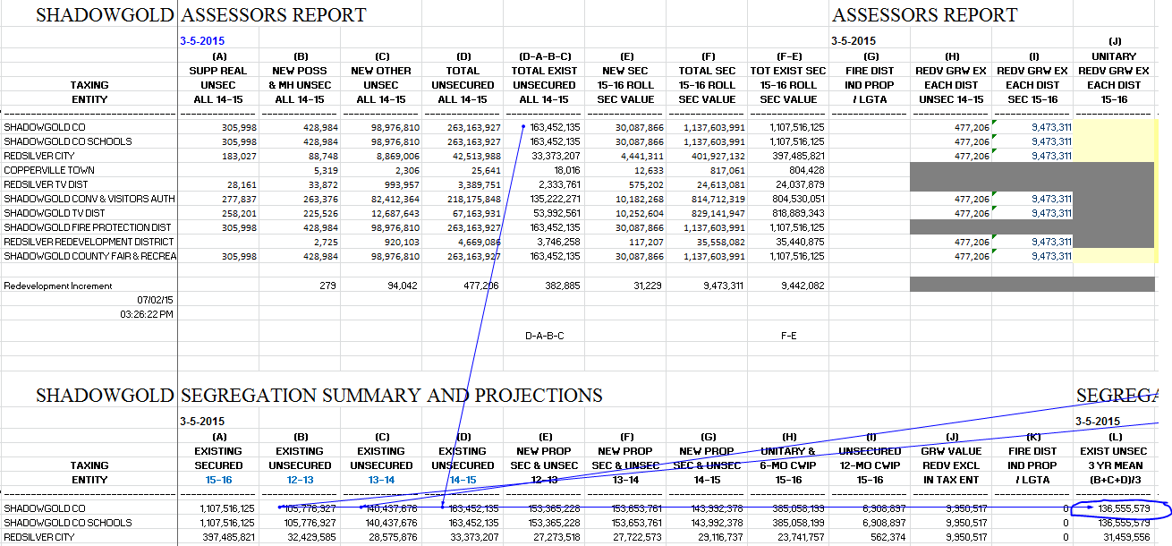
SEG – Assessor’s Ma / Pa Review
Dependents and Precedents (Cont.)

Slide 13
SEG – Assessor’s Ma / Pa Review
Dependents and Precedents (Cont.)

Slide 14
SEG – Assessor’s Ma / Pa Review
Estimates by District
Things to Consider:
New Properties Coming Onto the Roll
Board Changes / District True Ups
Redevelopment Consideration
Past Comparisons: Degree / Direction of Changes
Column M / P Projection Defaults:
Column M Uses Lower Value – Column D or L (3 Yr Avg)
Column P Uses Higher Value – Column G or O (3 Yr Avg)

Slide 15
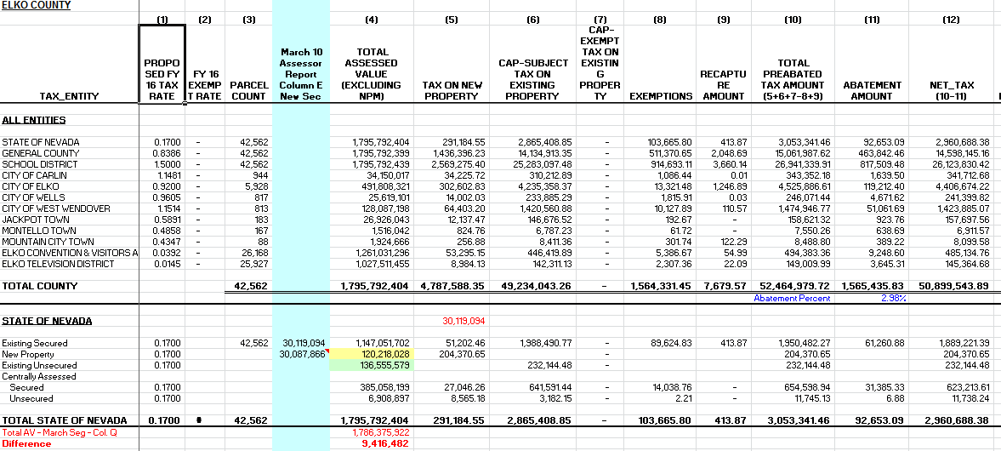
Understanding the Pro Forma Report

Slide 16
Understanding the Pro Forma Report

Slide 17
Issues – Exemptions & Abatements
Segregation Instructions – Net Assessed Values
Gross less Exemptions
SAR Reporting – Line Item Reporting
By Use
By Exemption Type
Both Reports – Value Associated with Property Receiving Abatements are Included
Abatement is on Revenue – Not Assessed Value
Impacts on Budget - Affects Individual Tax Entities Budgets
Applied at Billing
Typically Tracked and Reported by County Treasurer (Unsecured Exceptions)

Slide 18
SAR - Due Dates and Uses
May 5th - Unsecured Values
Preliminary Look and Review
Reporting Requirement - NRS 361.390
August 10th - Secured Values
Preliminary Look and Review
Reporting Requirement - NRS 361.390
October 31st – Both Secured & Unsecured Values
True Up of Prior Year Roll Close; Basis for Historical Comparisons
SEG Reports look Forward (Budgeting)
SAR looks Back (Historical)

Slide 19
SAR – Changing Environment
Changes in SAR Format
New Land Use Codes (LUCs)
Aligning to Expenditure Reporting - NRS 360.137 (AB 466)
Reasons Driving SAR Changes
Legislative Setting: Transparency and Relevancy to Legislative Process
Exemption Clarity
Division Implementation
Shifting Priorities
Changes in Work Processes
Attempting Consistency in Reporting

Slide 20
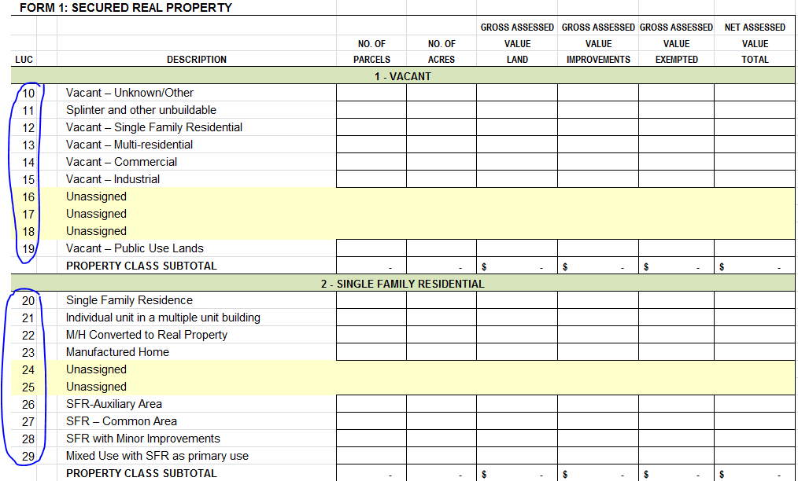
SAR – Revisions Preview
Aligning reporting with new Land Use Codes (LUCs)

Slide 21
SAR – Revisions Preview (Cont.)
Aligning exemption reporting with NRS references

Slide 22
Wrap Up
Assessor Requests (eg. Guidance Letter)
Key Points
Assessors are Local Knowledge Authorities
Per Statutes - Turn Around Time is Tight
Consistency Should Exist Between Numbers Provided to LGS and Local Budget Staff
When You Have Questions
Cheryl Erskine, Coordinator 775-684-2038
Kelly Langley, Supervisor LGF 775-684-2073

Slide 23
Questions and Answers

